Slide 1

Auction System
Group 3
Sena Tarpan, Peter Hoesch , Yun Ye
February, 2023

Slide 2
System Architecture
Client
…
Client
multi-server multi-client
main server and supplementary servers
UDP connection between clients and servers
Server
Client
Client
…
Server
Server
…
Client
Client
Server
Client
…
Client

Slide 3
Implementation
Message.json
Auction Component
ID: YhK7HvtYyvjbnyiFaU00FQ
METHOD: SET
SEQ: 0
CONTENT: {'MAIN_SERVER': ['172.17.112.1', 10001],
'is_member': True, 'CONTACT_SERVER': ['172.17.112.1', 10001]}
Server
Client
Group member service
METHOD | Description
JOIN | Dynamic discovery
SET | Remote parameter setter
GET | Remote parameter getter
REDIRECT | Message forwarding
BIT | Raise bit
RMI | Remote method invocation
… | …
Server
Client
Global time synchronizer
Utils
Config

Slide 4
Implementation
ELE
ELE
Port design
Logic Unit
Group Member Service
Global Time Synchronizer
Group Member Service
GMS
Logic
UDP
Global Time Synchronizer
TIM
Utils & Gadgets
Config

Slide 5
Fault tolerance
Process crash, message omission, Byzantine Fault
Voting
The LaLann-Chang-Roberts algorithm
Ordered reliable multicast
Totally ordered reliable multicast, B-multicast

Slide 6
Dynamic Discovery
4. Join
Server
Discovery and join
Assign and Accept
Message forwarding
Server
5. Accept
Client
Server
Server
3. Assign
Server
2. Forward
1. Discovery
Client
Client

Slide 7
Byzantine Agreement
Recursive Phase King Algorithm
King-stack
Step1
Get tiebreaker
Step2
Get Majority
Step3
Update value
Step1
Step2
Step3
Next Phase

Slide 8
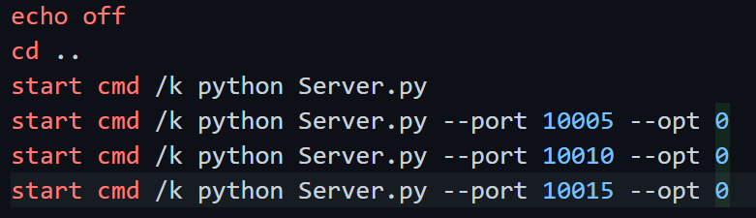
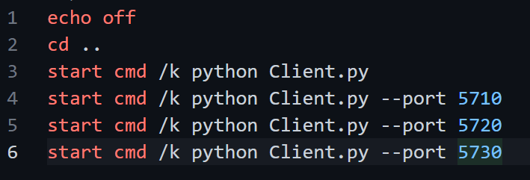
Demostration
ID | PC | PORT
1 | 1 | 10000
2 | 1 | 10010
3 | 1 | 10020
4 | 1 | 10030
5 | 2 | 5720
6 | 2 | 5710
7 | 2 | 5730
8 | 2 | 5740
9 | 3 | 57??
System Layout:
4-servers
5-Clients

Slide 9

Q & A

Slide 10

Thanks for attention!

